Slide 1



UNIT 7:
On top of the world
Animals –
hot and cold

Slide 2
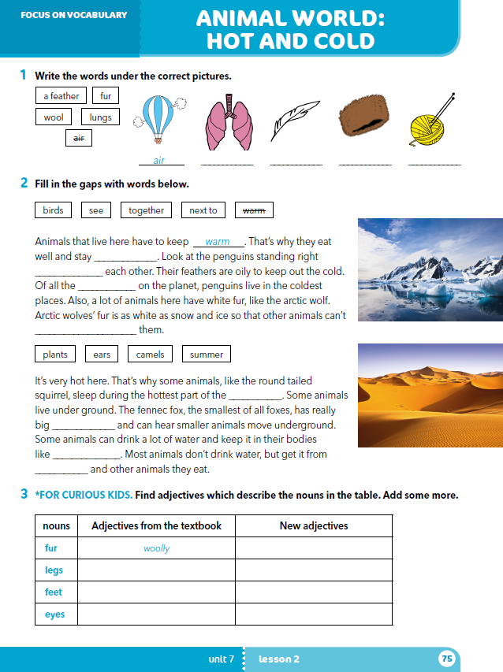
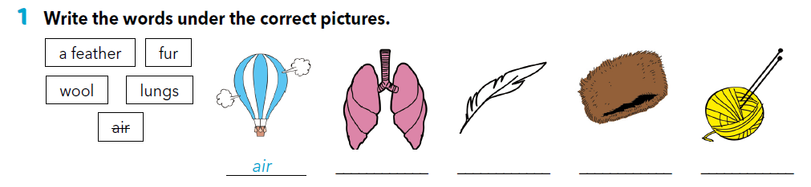
workbook p. 75
lungs
a feather
fur
wool
Translate:
air = fur =
lungs = wool =
a feather =
zrak
krzno
pluća
vuna
pero

Slide 3
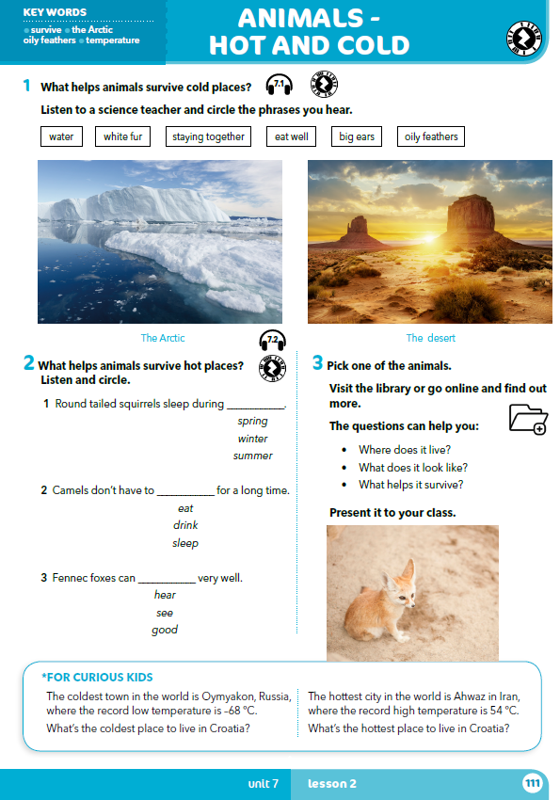
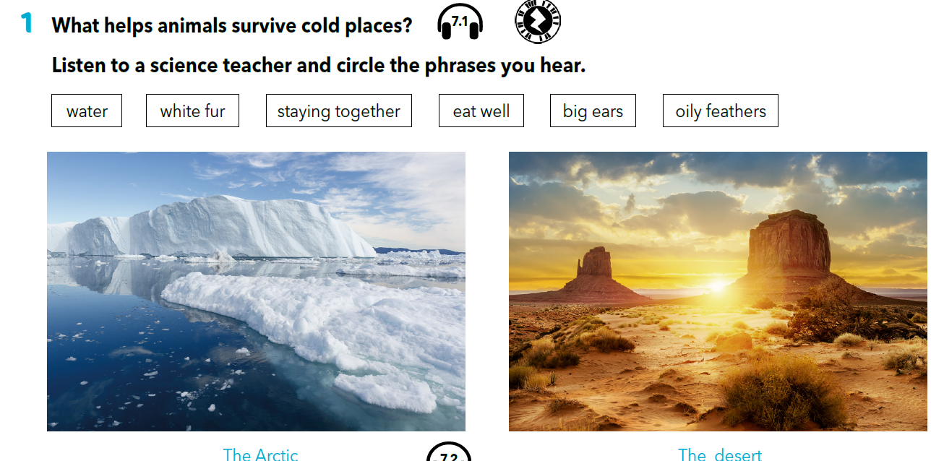
Do you know any animals who live in cold places?
Would you like to visit these places?

Slide 4
Translate:
voda bijelo krzno ostati skupa kvalitetno jesti velike uši masno perje
Which of these things helps animals survive in cold places?

Slide 5

https://www.e-sfera.hr/dodatni-digitalni-sadrzaji/8de7e508-6d71-4a76-820d-a2585bc15b57/assets/audio/52_unit_7_cold_places.mp3
Do you know any animals that live in hot places?
Can any of the things in task 1 help animals survive deserts?
What else can help them?

Slide 6
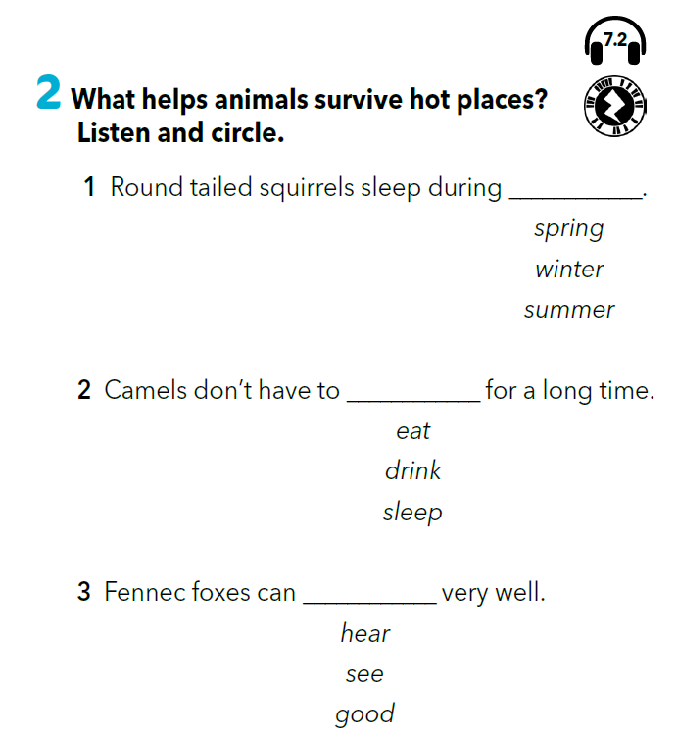
https://www.e-sfera.hr/dodatni-digitalni-sadrzaji/8de7e508-6d71-4a76-820d-a2585bc15b57/assets/audio/7_2__hot_places.mp3
summer
drink
hear

Slide 7
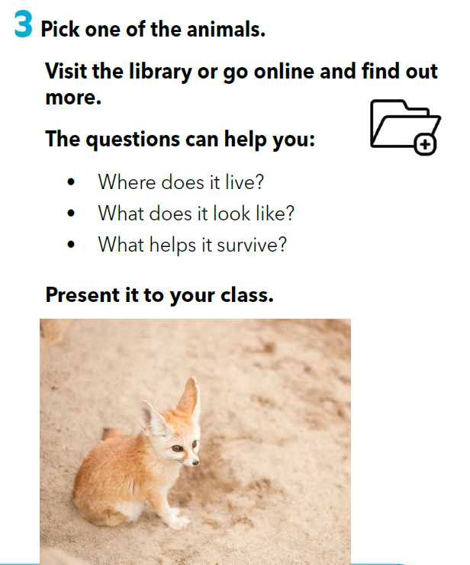

Slide 8
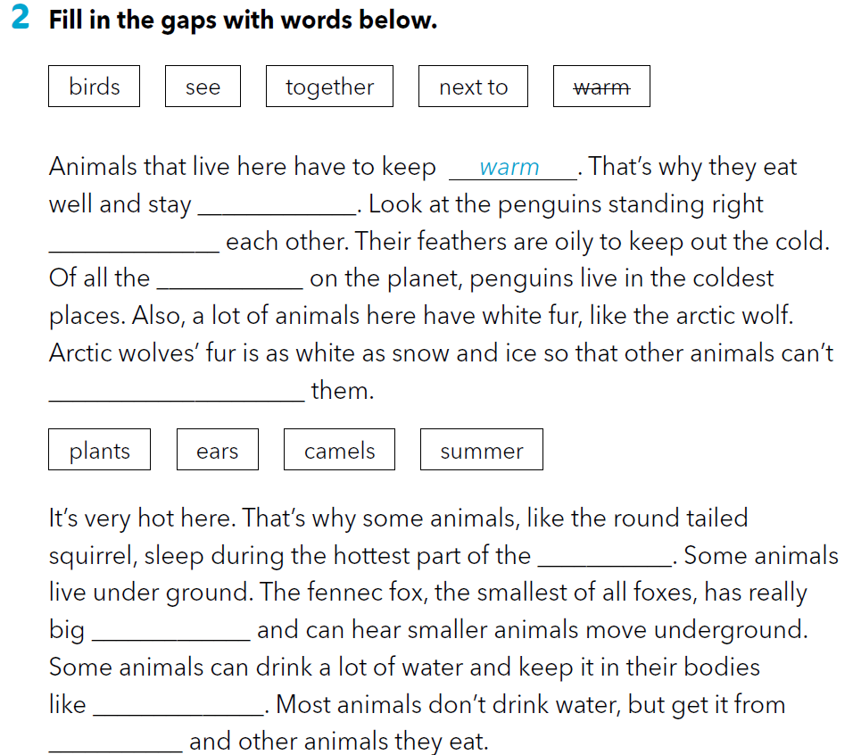
Workbook p 75.
together
next to
birds
see
summer
ears
camels
plants

Slide 9
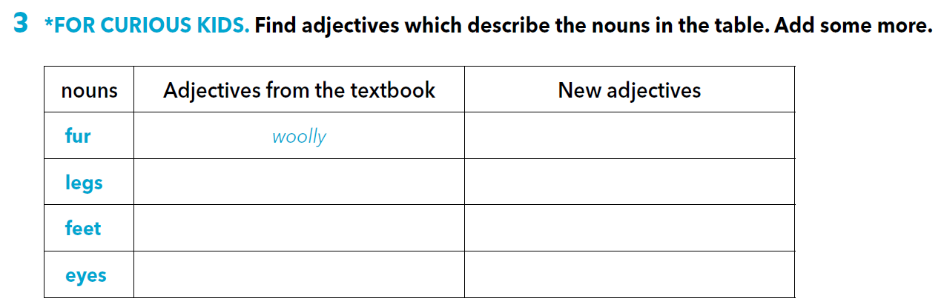
, thick, white
long
strong, short, long
hairy
small
gigantic
big
red

Slide 10
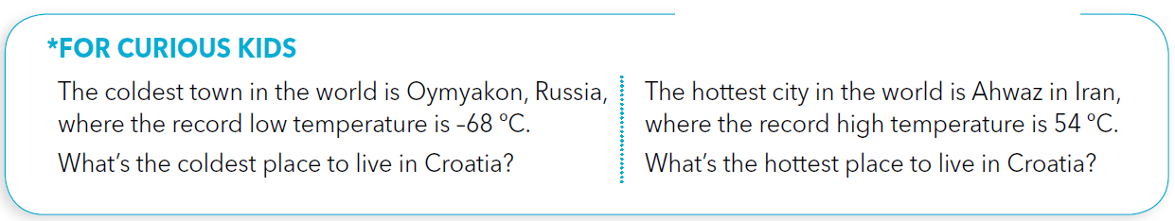
LET’S REVISE!
https://wordwall.net/play/260/327/145

Slide 11

SELF CHECK.
https://www.e-sfera.hr/dodatni-digitalni-sadrzaji/8de7e508-6d71-4a76-820d-a2585bc15b57/
LEARN MORE.
https://www.e-sfera.hr/dodatni-digitalni-sadrzaji/8de7e508-6d71-4a76-820d-a2585bc15b57/
Endangered species

